Slide 1
GCD INSAID - Exploratory Data Analysis Term Project
Sumit Agarwal (Data Scientist)
19 – June - 2022

Slide 2
Agenda
Executive Summary & Problem Statement
Data Profile & Transformations
Exploratory Data Analysis (EDA)
EDA Summary
Actionable Insights / Value Adds

Slide 3
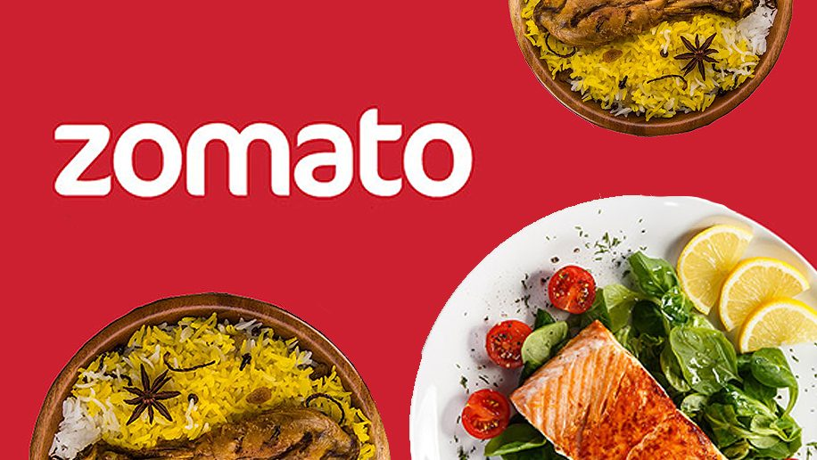
Executive Summary & Problem Statement
Executive Summary
Zomato is an Indian multinational restaurant aggregator and food delivery company. Zomato provides information, menus and user-reviews of restaurants as well as food delivery options from partner restaurants in select cities. Zomato has been instrumental in visibility of restaurants to Zomato users and also facilitated them with reviews, ratings and other observations.
The data generated by Zomato Subscriptions and reviews/ratings by users is very useful in generating useful insights contributing to value added decision making and data monetization.
Intended Audience
Zomato’s Senior Executives
Web/Mobile App Product Managers
Sales Executives
Operations Manager
Problem Statement
Understand Zomato’s restaurant coverage and generate meaningful insights which can add value to their business.
To evaluate the pattern of restaurant ratings and on what factors rating are dependent upon.
Understand the most served cuisines and on what locations.
Zomato wants to monetize this data and sell insights to existing & new upcoming restaurants so that restaurant owners can take better & informed data driven decisions in choosing cuisines, cost and locations.

Slide 4
Data Profile & Transformations
Dataset & Profile Information
Two Datasets were taken into account. Zomato and country dataset. Zomato dataset has all the information and only country codes were provided in country dataset.
There are 21 columns in Zomato dataset and 9551 observations. There are 7 numeric, 10 categorical and 4 Boolean variables.
The data is almost complete and don't have null values except 9 cells for Cuisines column. This is not a significant number can be left as is.
All the 9551 Restaurant Ids are unique however Restaurant names are repetitive. Which means that there are franchise or restaurant chains have more than 1 restaurants.
There are distinct 15 Country Ids in Zomato dataset and all are inline with country dataset.
Zomato covers 142 cities worldwide.
There are multiple combination of Cuisines served by restaurants. North India Cuisine seems to be most popular.
Average cost for two seems to have value as 0 (zero) for some restaurants which seems to an error.
Aggregate rating is one of the most important column for this EDA. Around 22.5% of records have 0 (zero) as its value which essentially might indicate that these restaurants are not rated.
Transformations
Country column from country dataset was merged to Zomato dataset basis on Country Id.
Dropping following columns - 'Address', 'Country Code', 'Restaurant ID’.
Replaced 0(zero) ‘Average Cost for two’ with mean value of the same column.
Creation of new dataframe with records only from India.

Slide 5
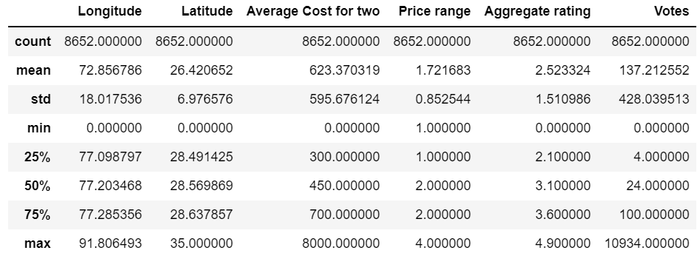
Data Profiling (India dataset) Cont..

Slide 6
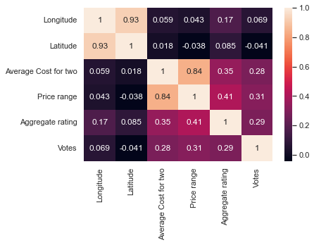
Dataset Correlation

Slide 7
Exploratory Data Analysis (EDA)
Exploratory Data Analysis is an approach of analyzing data sets to summarize their main characteristics, often using statistical graphics and other data visualization methods.
What would we do here:
Create number of data analysis use cases and derive the outcome in form of data table, statistical charts and other kind of visuals.
Analyze correlation between all the parameters and make a judgement of dependencies & cause effect relationships.
Understanding the behavior of data distribution via Histograms and Kernel Density Estimation charts.
Analyze the geographical spread of locations by plotting over Google Maps widget.
Bar Charts for visualizing the quantity or count of continuous variables.
Box Plots for visualizing Quarters, Interquartile ranges and outliers.
Donut charts for % distribution between number of segments or clusters.
All in all it’s a visual way of representing the data summarization from all the aspects.

Slide 8
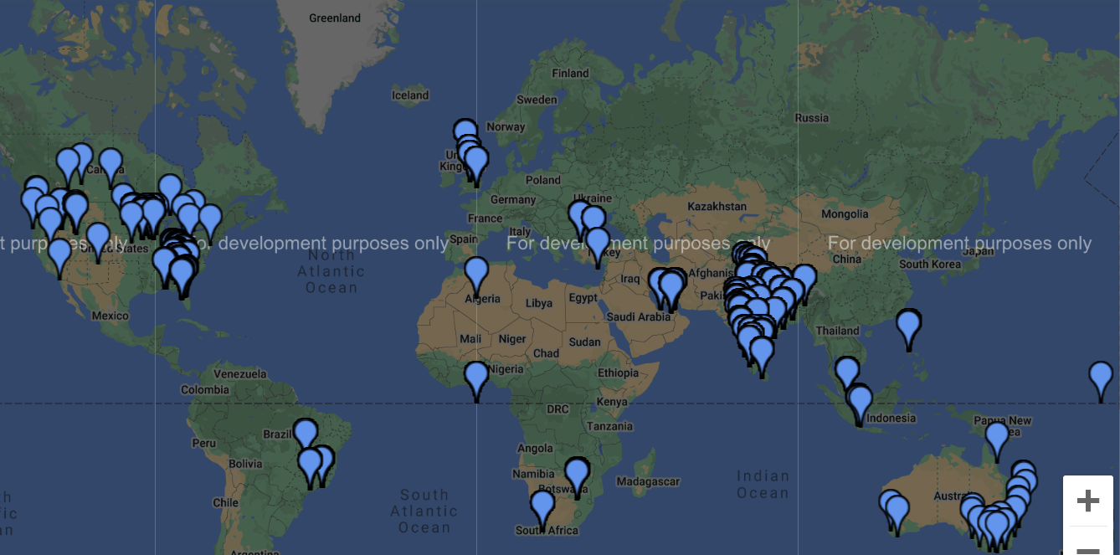
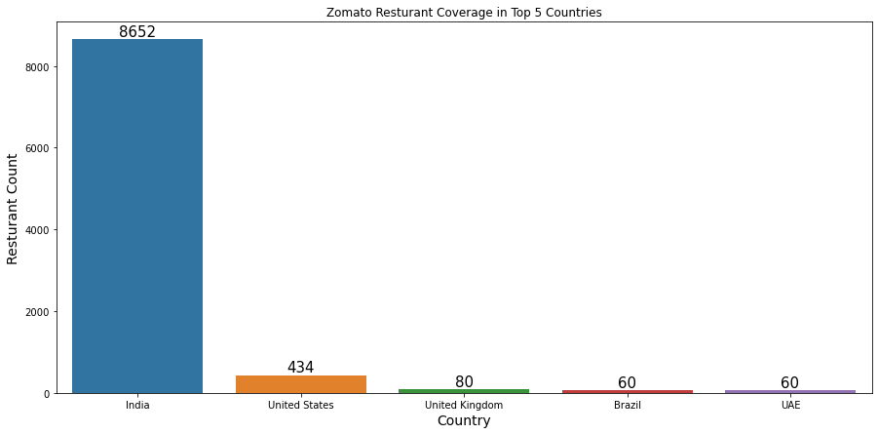
EDA-Worldwide Zomato Coverage of Restaurants

Slide 9
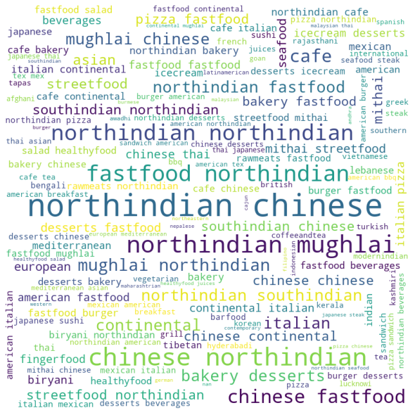
EDA - Cuisines Served Worldwide

Slide 10
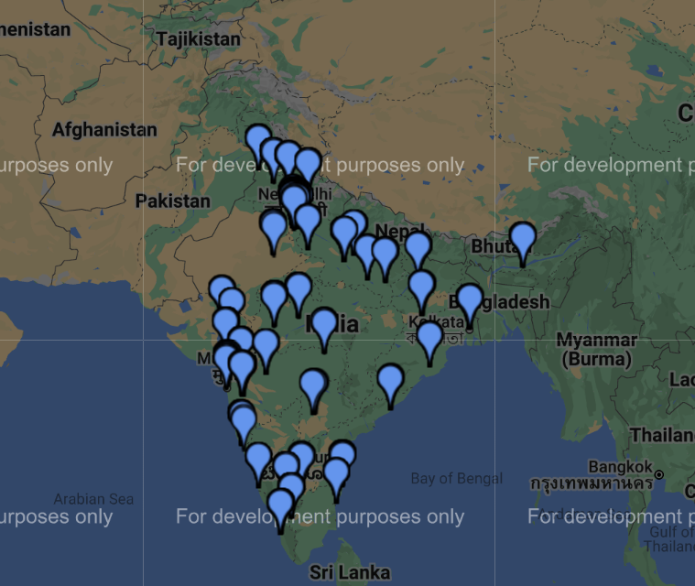
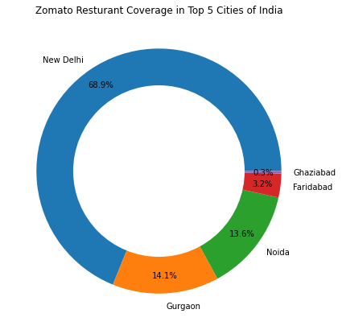
EDA-India Cities Zomato Coverage of Restaurants

Slide 11
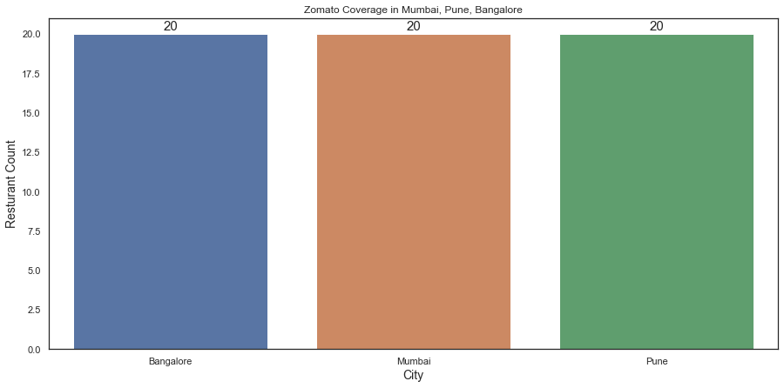
EDA-Zomato Coverage of Restaurants in Mumbai, Bangalore & Pune

Slide 12
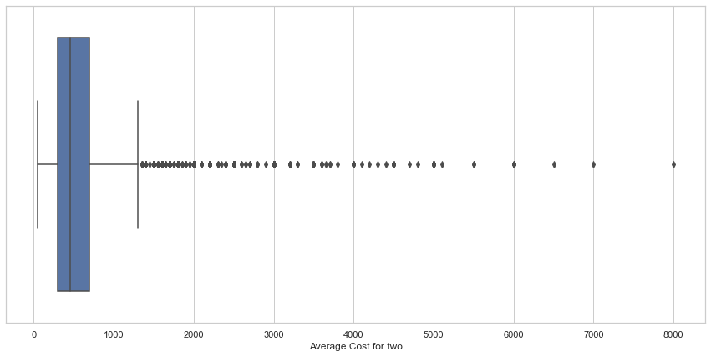
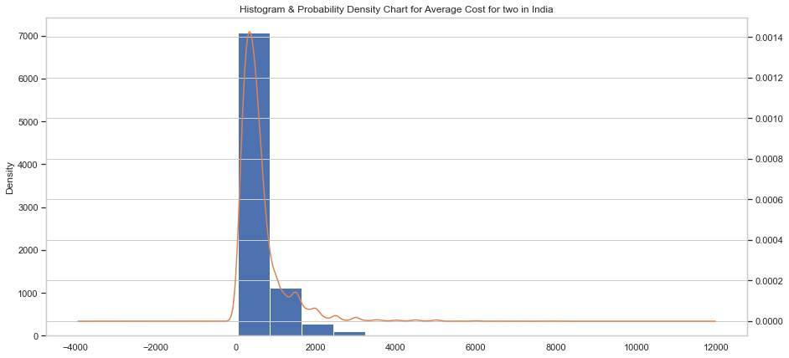
EDA-Understanding “Average Cost for two” for India Restaurants
The mean of “Average Cost for two” in India is around 624 and the restaurants with cost more than 1300 are outliers. There are 813 such restaurants in India.

Slide 13
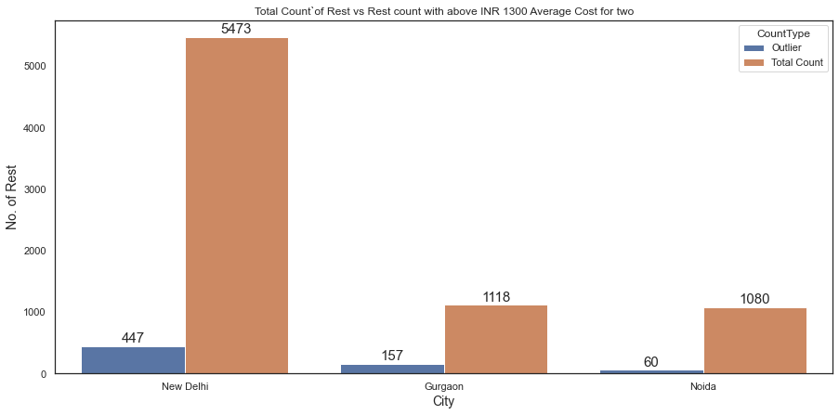
EDA - Understanding “Average Cost for two” Cont..
% of Restaurants Above 1300 “Average Cost for two” ------ New Delhi – ~8% | Gurgaon – ~14% | Noida – ~5%

Slide 14
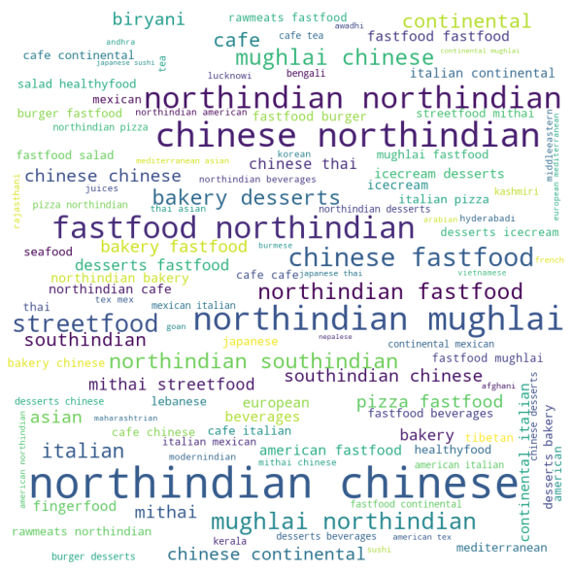
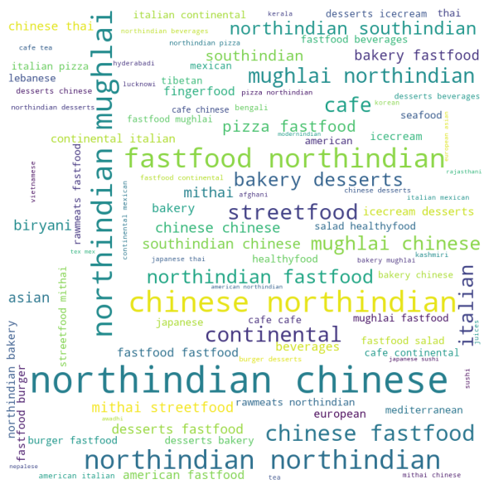
EDA-Most Served Cuisines in India & Delhi/NCR (Del, GGN, Noida)
India
Delhi / NCR

Slide 15
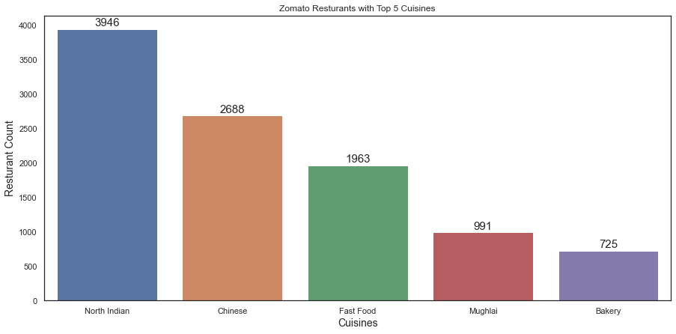
EDA - Cuisine Analysis Cont..

Slide 16
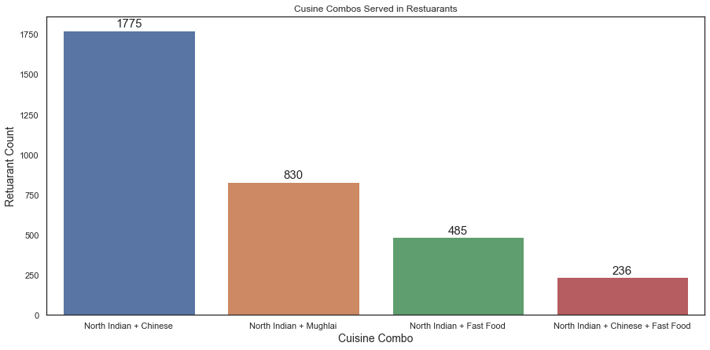
EDA - Cuisine Analysis Cont..

Slide 17
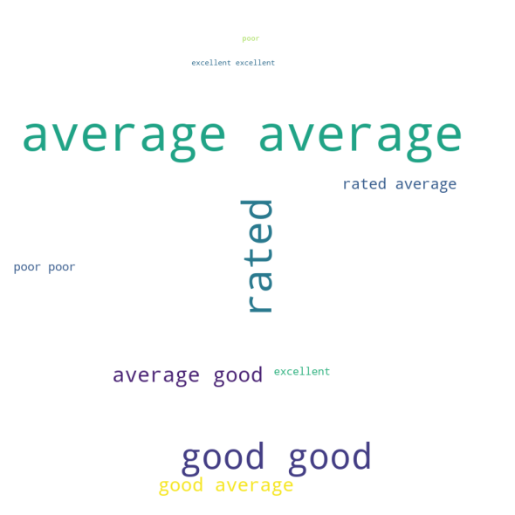
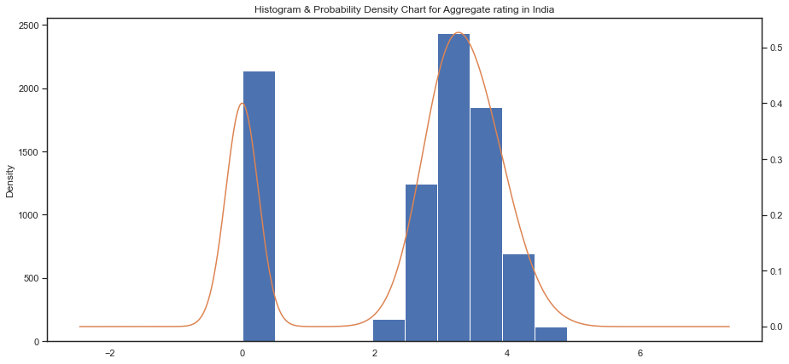
EDA - Understanding Aggregate Rating & Text
There are 2139 unrated restaurants and have Rating as 0 (Zero).

Slide 18
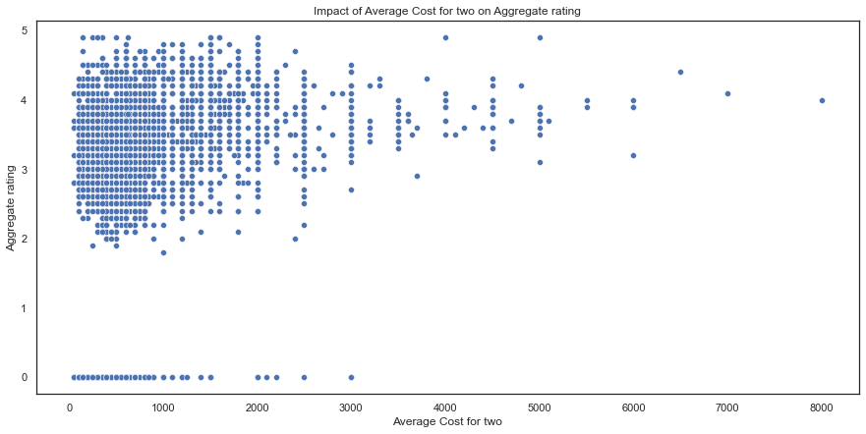
EDA - How is Aggregate Rating Impacted by Other Factor..

Slide 19
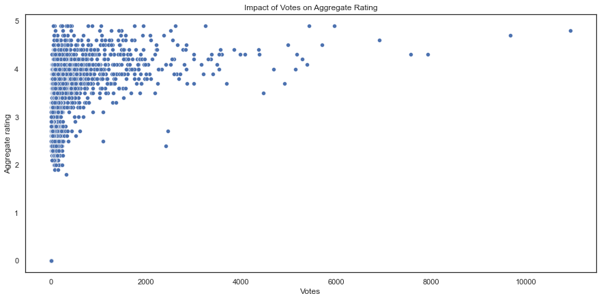
EDA - How is Aggregate Rating Impacted by Other Factor..

Slide 20
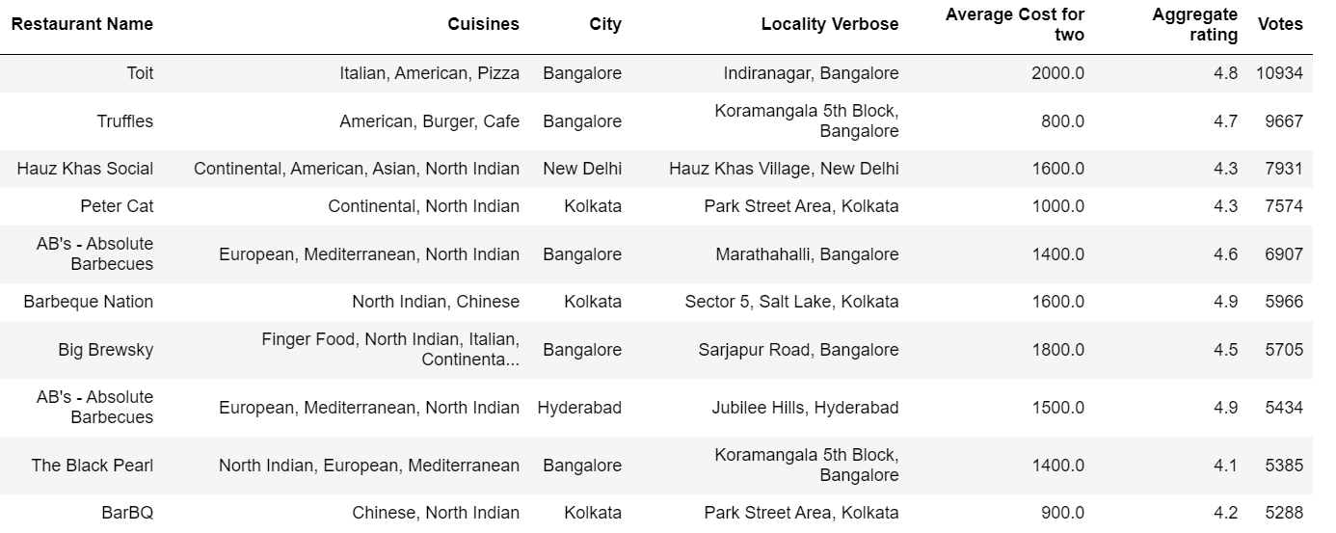
EDA - Top 10 most voted Restaurants from India?

Slide 21
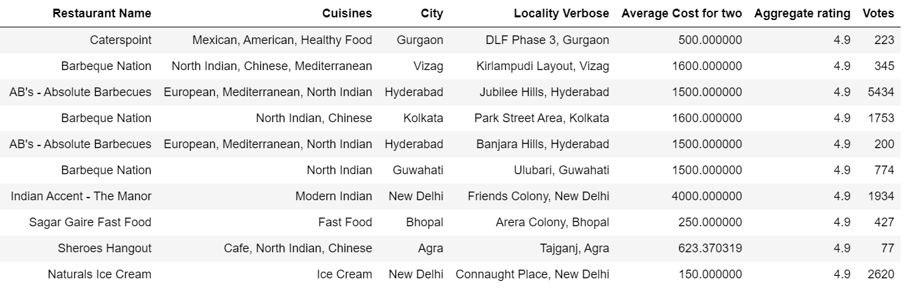
EDA - Top 10 Restaurants in India has highest Aggregate Rating

Slide 22
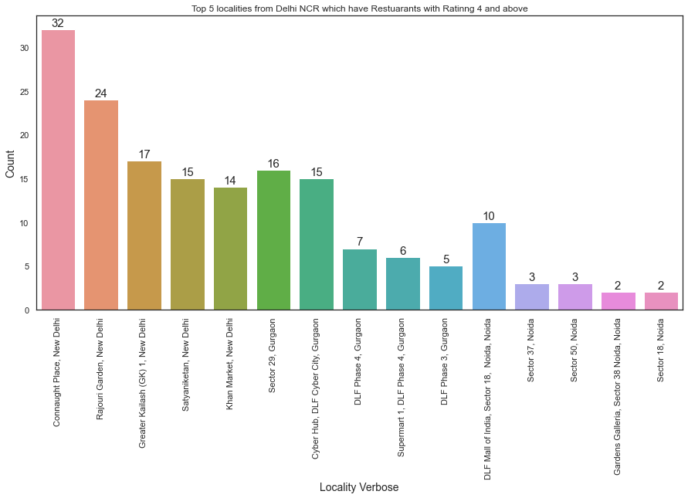
EDA – Localities in Delhi NCR with High Rated Restaurants

Slide 23
EDA Summary
Below are the outcome of EDA over Zomato dataset.
Zomato Coverage
Zomato's presence is there in around 15 countries and the coverage is highest in India.
New Delhi, Gurgaon and Noida are the top 3 cities under Zomato coverage with New Delhi highest.
Places such as Mumbai, Pune and Bangalore has very low Zomato coverage.
Cuisines
North Indian is the most served Cuisine across India and majority of restaurants serve Chinese along with North Indian.
There are total 90 unique cuisines which are served in India.
North Indian is the most served cuisine in India and Delhi/NCR region followed by Chinese, Fast Food and Mughlai.
Average Cost for two
The mean of Average Cost for two in India around INR 625.
The most of the restaurants in India have Average cost for two under INR 1300. Anything post 1300 is an outlier.
The total restaurants in India with outlying Average Cost for two is 813 only.
Around 8% restaurants in New Delhi have Average cost for two above INR 1300.
Around 14% restaurants in Gurgaon have Average cost for two above INR 1300.
Around 5% restaurants in Noida have Average cost for two above INR 1300.
The restuarants with Avg cost for two lower than 1000 do not focus much on the customer votes and reviews. Lot of restuarants are unrated in that category.

Slide 24
EDA Summary Cont..
Votes & Aggregate Rating
The maximum number of restaurants in India are Average Rated.
There are 2139 restaurants which are not rated and number of votes is very less. This probably means that these restaurants have very low foot falling.
Average Cost for two does not seem to have any impact on Aggregate Rating of the restaurants.
It is observed that higher the number of votes higher the rating, but these observations are very less in number.
There are only 40 restaurants which have number of votes greater than 2000 however their rating is either close to 4 or above 4. It means higher votes, higher footfall and higher ratings.
Other Observations
Out of top 10 most voted restaurants, 5 are from Bangalore and only 1 from New Delhi. This is quite interesting.
The Average cost for two for top 10 most rated restaurants is between 1000 and 2000 that to very close to 1300.
In New Delhi, Connaught Place has most number of restaurants with rating 4 & above.
In Gurgaon, Sector 29 has most number of restaurants with rating 4 & above.
In Noida, DLF Mall of India, Sector 18 has most number of restaurants with rating 4 & above.

Slide 25
Actionable Insights / Value Adds
Actionable Insights for Zomato Management
Zomato already has huge coverage in India and already have baseline operations, marketing and management team. There is a great opportunity to increase coverage in other cities of India. Cities such as Bangalore, Pune and Mumbai has very young population which makes them next big opportunities for Zomato.
The restaurants with higher ratings should appear at the top on search pages within Zomato app/web.
Zomato should update the UI/UX of app/web to ensure users start voting and rate the restaurants. This will help create a more useful data for Zomato.
Recommendations for Restaurant Owners for Monetization Through Data
Its recommended for existing & potential restaurant owners to serve North Indian & Chinese Cuisines. Indian people seems to be in love with this combination of food. For Delhi NCR region Mughlai is a great food choice as well.
The potential owner should prefer Gurgaon within Delhi NCR, if the “Average Cost for two” is more than INR 1300.
To be top rated restaurant, the restaurant owner can have “Average Cost for two” between 1000 and 1800.
People in Bangalore seems to vote & rate restaurants a lot, so it should be must of Bangalore based restaurants to have good number of votes and decent rating.
To see a greater footfall & among best rated restaurants, the below localities should be preferred for potential restaurants:
New Delhi - Connaught Place & Rajouri Garden
Gurgaon - Sector 29 & DLF Cyber Hub
Noida - DLF Mall of India Sector 18 & Sector 37

Slide 26
Thank You..

